Slide 1
NanoNet

Slide 2
Segmentation and feature extraction of same NDs
Comparison between different NDs

Slide 3
Segmentation and feature extraction of same NDs
Select input path
tool to navigate to Navigate to file orders: -> command paths(f1) f1=r:”…

Slide 4
Segmentation and feature extraction of same NDs
Select input path
Type in pixel size
textbox where user can type in the pixelsize of the images: -> pixel= user input
Pixelsize: userinput

Slide 5
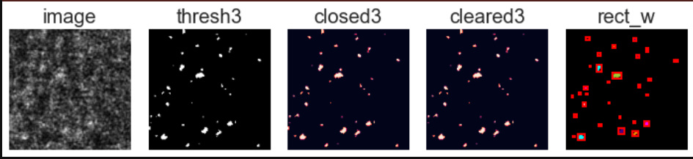
Segmentation and feature extraction of same NDs
Select input path
imagebox where the currently segmented images are displayed
Type in pixel size
Observe segmentation
More explanation what the images display:
Raw image- gaussian blurring and lambda thresholded – morpholocial closing- morpholocial clearing – watershed and object detection

Slide 6
Segmentation and feature extraction of same NDs
Select input path
Type in pixel size
Observe segmentation
Save results
notation to user that the extracted features are stored in the location of the input folder: if possible also add a navigator to save the results elsewhere and a textbox allowing the user to rename the excel

Slide 7
Comparison between different NDs
Select input path
tool to navigate to multiple file orders: -> list [r:”C…., …]
File1: userinput
File2: userinput
File3: userinput

Slide 8
Comparison between different NDs
Select input path
order of conditions
textbox where you can enter the order in which the boxplots will be: oder[ one, two three….]
first: MS
second: NACL
third: Sorbitol
function semua (listpaths, listorder)

Slide 9
Comparison between different NDs
Select input path
order of conditions
Randfom Forest:
test_size: default=0.2
n_estimators: default=1000
min_samples_split: default=2
min_samples_leaf: default=1
max_features: default="sqrt“
max_depth: default=110
K-NN:
test_size: default=0.2
n_neighbors: default=3
parameter setting
TSNE:
n_components: default=2
Perplexity: default=20
n_iter: default=500
Choose which x and y?

Slide 10

Comparison between different NDs
Select input path
order of conditions
parameter setting
estimation of K-NN optimal number
Optimal number of neighbours is: displayed value
Accuracy of K-nn: display accuracy

Slide 11
Comparison between different NDs
Select input path
order of conditions
parameter setting
Get estimation of K-NN optimal number
Randfom Forest:
test_size: default=0.2
n_estimators: default=1000
min_samples_split: default=2
min_samples_leaf: default=1
max_features: default="sqrt“
max_depth: default=110
K-NN:
test_size: default=0.2
n_neighbors: default=3
new parameter setting or leave parameter for K-NN

Slide 12
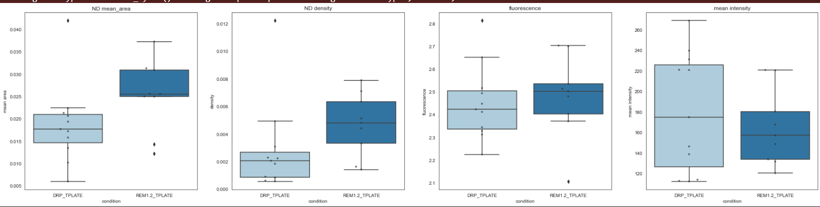
Comparison between different NDs
Boxplots
TSNE
Knn
RF
Select input path
order of conditions
parameter setting
Get estimation of K-NN optimal number
new parameter setting or leave parameter for K-NN
Display results and save results

Slide 13
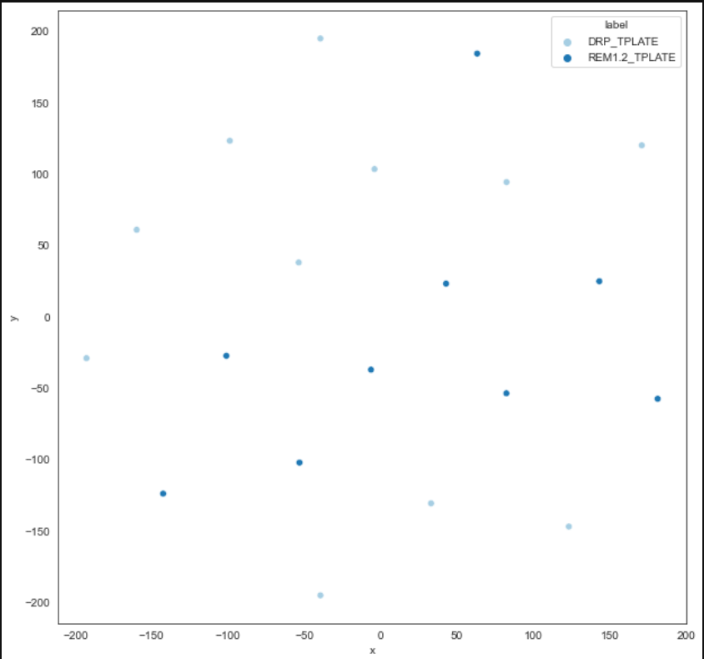
Comparison between different NDs
Boxplots
TSNE
Knn
RF
Select input path
order of conditions
parameter setting
Get estimation of K-NN optimal number
new parameter setting or leave parameter for K-NN
Interactive plot where you can hover over the datapoint and see image name?
Display results and save results

Slide 14
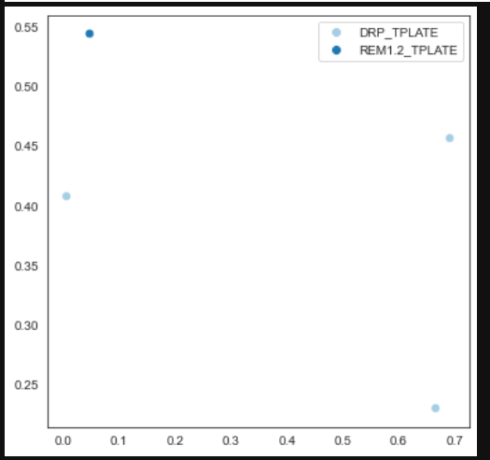
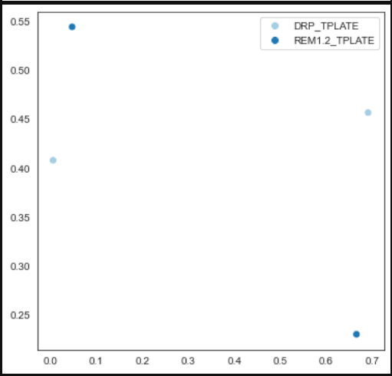
Comparison between different NDs
Boxplots
TSNE
Knn
RF
Select input path
Predicted labels
True labels
order of conditions
parameter setting
Get estimation of K-NN optimal number
new parameter setting or leave parameter for K-NN
Display results and save results

Slide 15
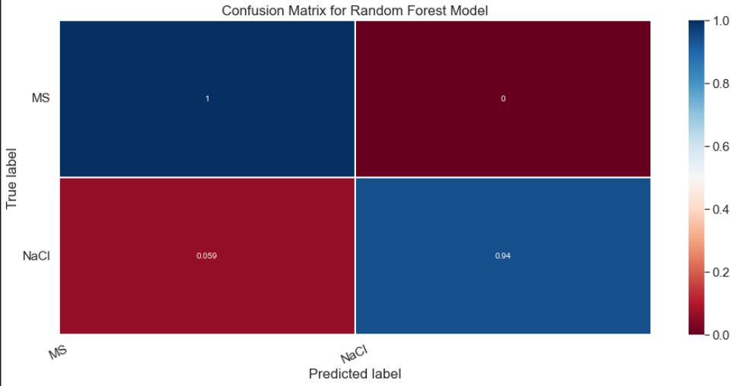
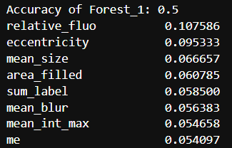
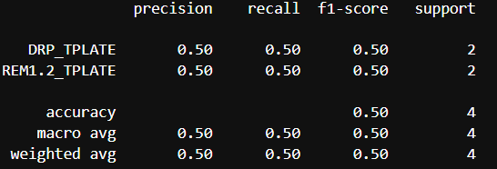
Comparison between different NDs
Boxplots
TSNE
Knn
RF
Select input path
order of conditions
parameter setting
Get estimation of K-NN optimal number
new parameter setting or leave parameter for K-NN
Display results and save results

Slide 18
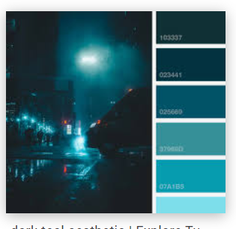

Slide 19
